Slide 1


Synoptic Operative Reporting for Breast Cancer Procedures:
Toolkit Preview
March 15, 2022
ilcancer.org

Slide 2
Housekeeping
Please stay on mute unless you have a question
Enter questions in the chat anytime or ask them after the presentation
The recording will be shared on ilcancer.org after the presentation

Slide 3

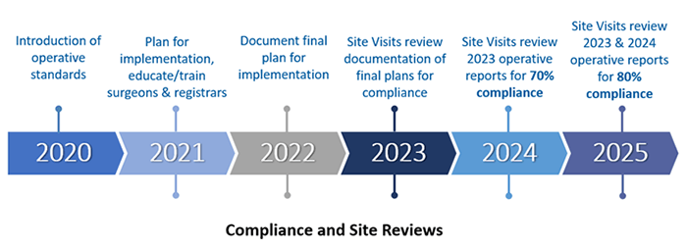
CoC Timeline for Implementation of Standards 5.3-5.6
https://www.facs.org/quality-programs/cancer/news/program-requirements-091620

Slide 4
How we can help you:
Approach to Implementing CoC’s Synoptic Operative Reporting Standards
    1. Work together to meet new mandate
        Initial focus: breast surgery
        Learn lessons, expand to melanoma and colon
2. Preparation for smooth implementation
      Focus groups and surveys of stakeholders
        https://northwestern.az1.qualtrics.com/jfe/form/SV_elMMKTjDLGSlvAG
  3. Toolkit for implementation
    Resource for systematic implementation of Standards 5.3-5.6 at your institution
    Offer a spectrum of options for implementation (report content, EMR templates, dictation resources)
    How to engage & obtain feedback from relevant stakeholders
    Preparation for CoC site visits
    Monitor compliance

Slide 5
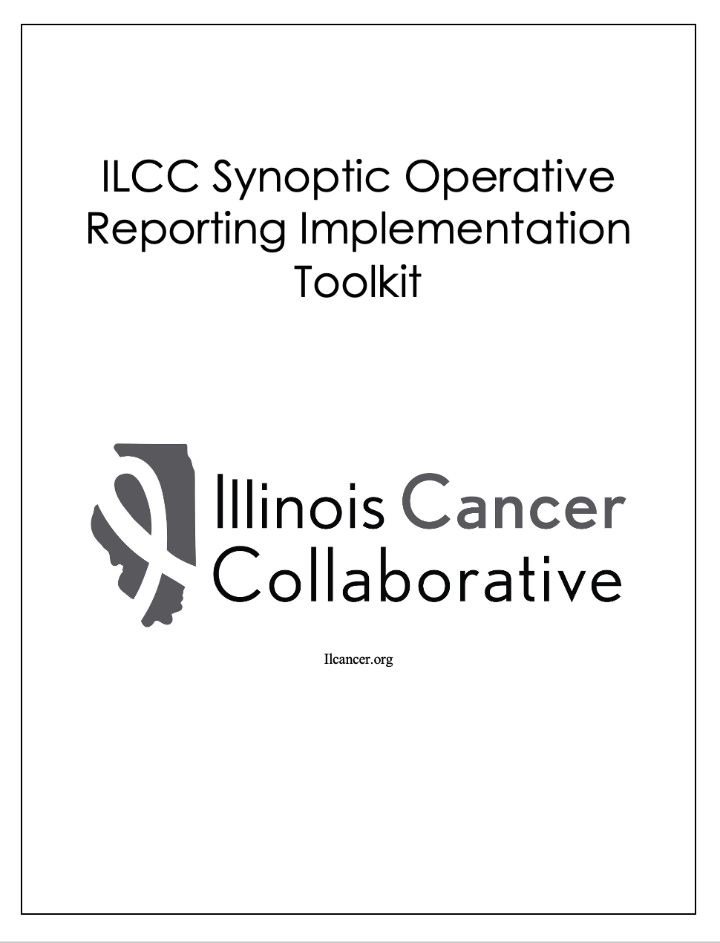

Slide 6
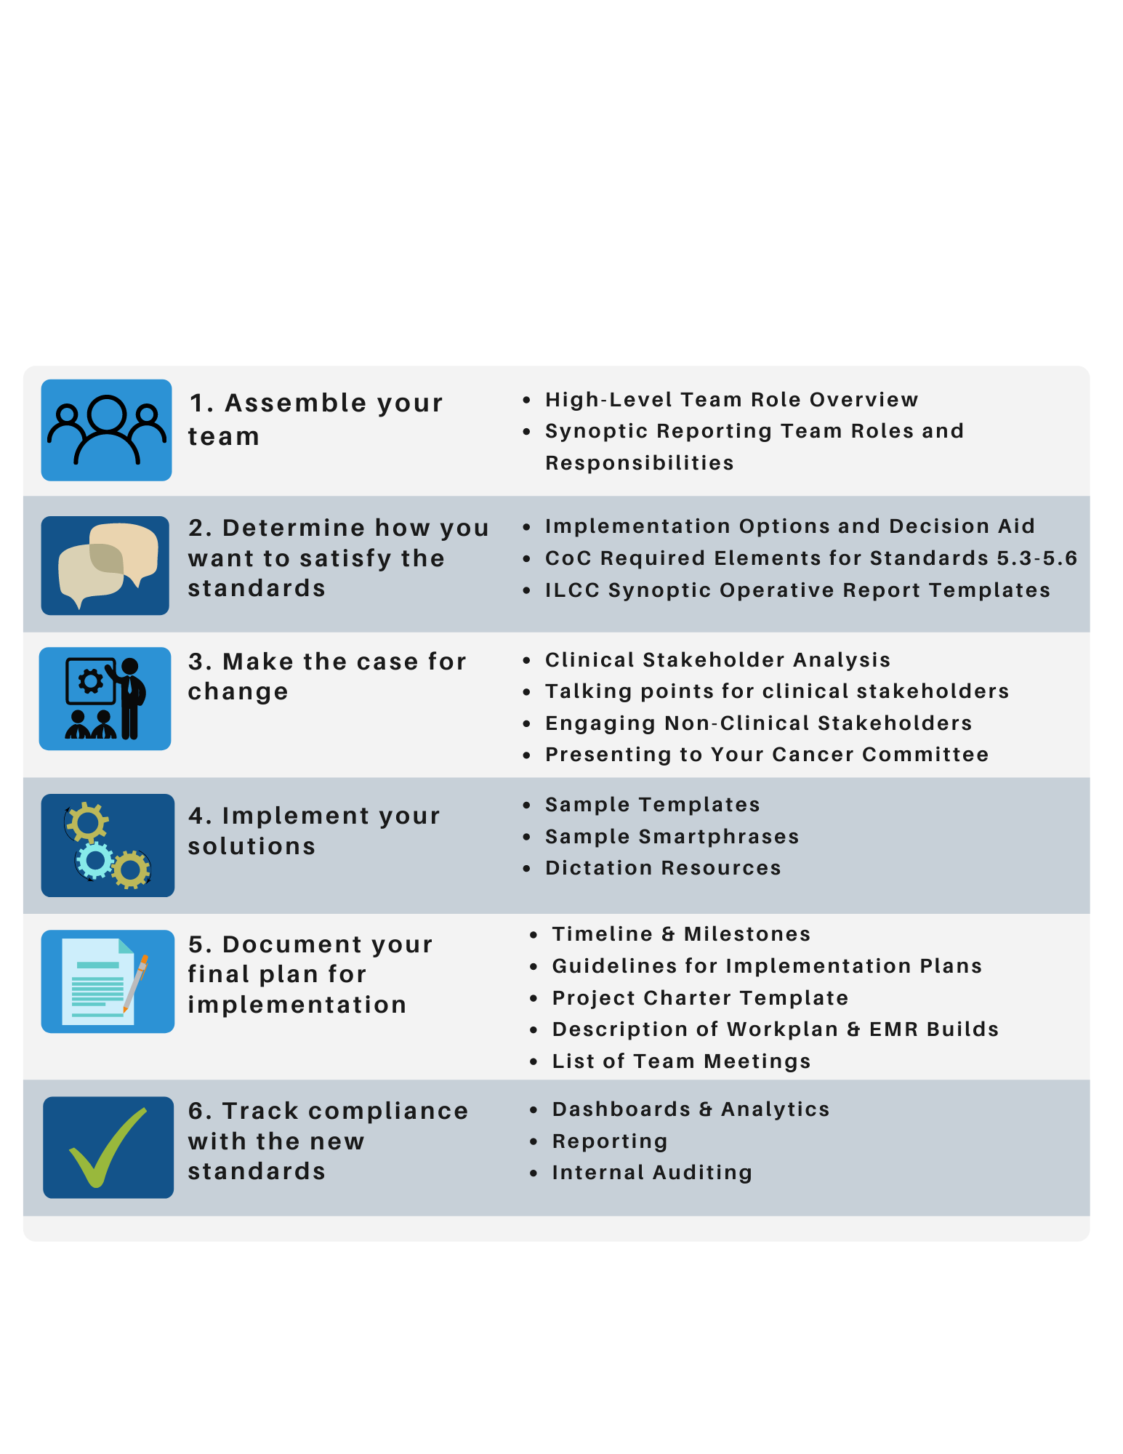
ILCC Roadmap for Implementation

Slide 7
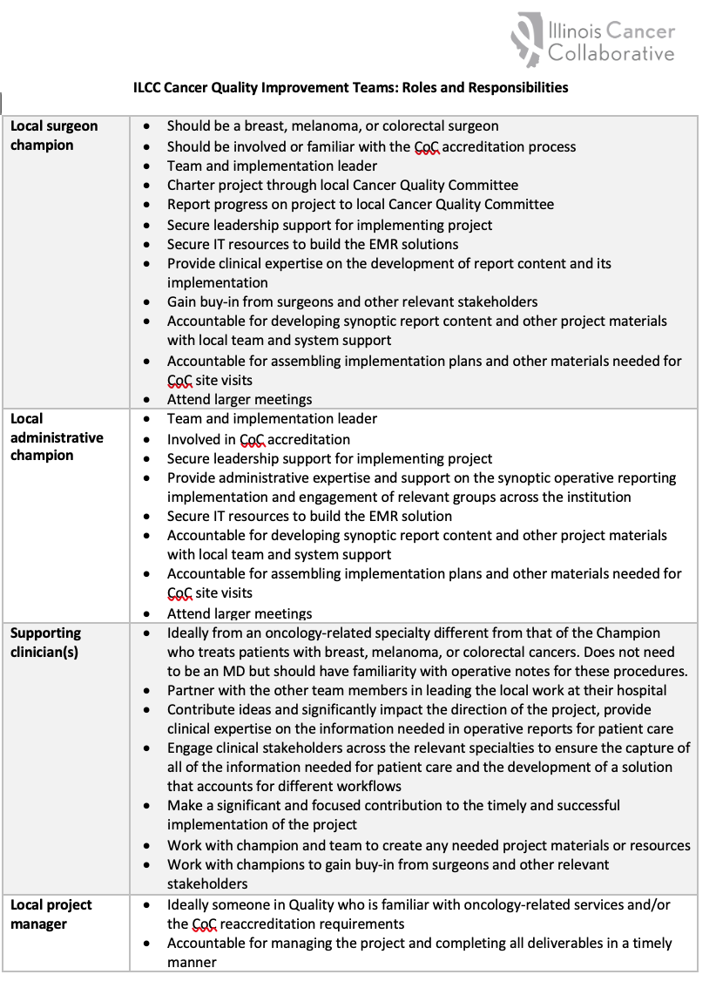
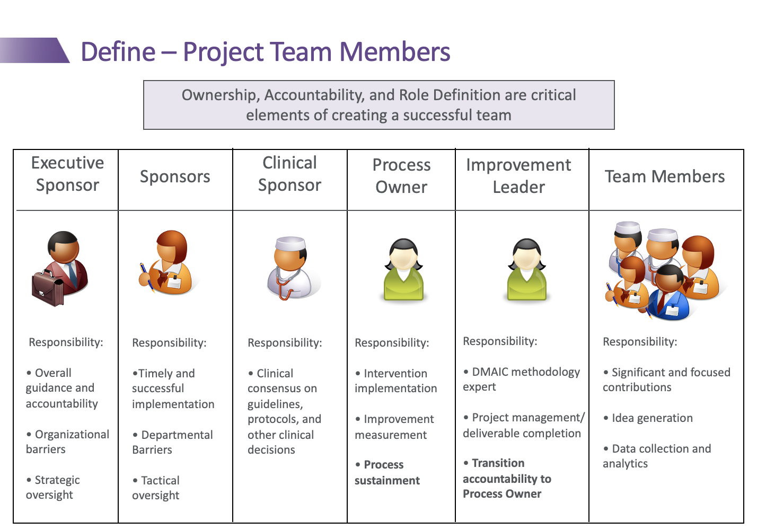
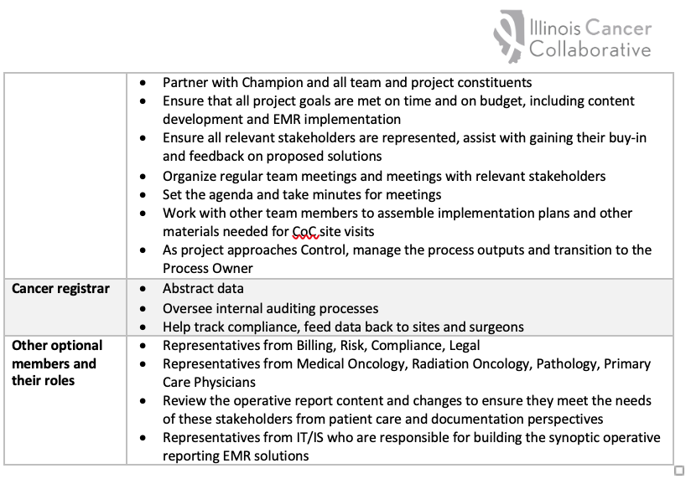
1. Assemble your team

Slide 8

2. Determine how you want to satisfy the standards
Decision Aid for Implementation Options
  Full/hybrid/minimum synoptic fields
  Considerations for EMR solutions
ILCC Synoptic Operative Report Content for Standards 5.3-5.6
  Content needed to develop fully synoptic operative reports, can be adapted to meet your hospital’s needs
  Options for mapping fields and branching logic

Slide 9
2. Decision Aid
Implementation Option | Approach | ACS Compliance | Flexibility of Content Captured as Synoptic Fields | Flexibility of Operative Report Documentation Methods | Time Saved by Surgeons Writing Operative Reports | Labor Needed to Implement | Level of Buy-in and Education of Surgeons, Other Clinicians, Staff | Discrete Data Available for Registrars and Research/QI
1. Transition to entirely synoptic operative reports for the required procedures | Contract with third-party vendors | Yes, with automated updates | Minimal; Content is determined by third-party vendor using ACS templates | Least; All surgeons must transition to one solution | Most; Due to fully synoptic “checklist” format | Minimal; Mostly IT for installation | Highest | All
2. Implement a hybrid synoptic operative report for the required procedures | Develop by hospital with input from surgeons, other clinical stakeholders, and staff, in partnership with IT staff | Yes, with manual updates for non-Epic hospitals | Most; Hospital determines what information will be captured discretely in addition to the required elements | Medium; Requires some change to workflows but potential for surgeons to maintain existing documentation methods | Some; Due to incorporation of some synoptic fields | Most; Both clinicians and IT | Medium | Determined by hospital and fully customizable to their needs
3. Implement only the elements required by the CoC for the required procedures | Build a template or smartphrase Note: Hospitals using Epic can use ACS CoC templates | Yes, with manual updates for non-Epic hospitals | None; The required elements and responses must use ACS CoC wording | Most; Surgeons can maintain existing documentation methods | None; Surgeons maintain existing workflow with minor changes | Some; Mostly IT for development, implementation, and ongoing maintenance | Lowest | Minimal; Only the required elements

Slide 10
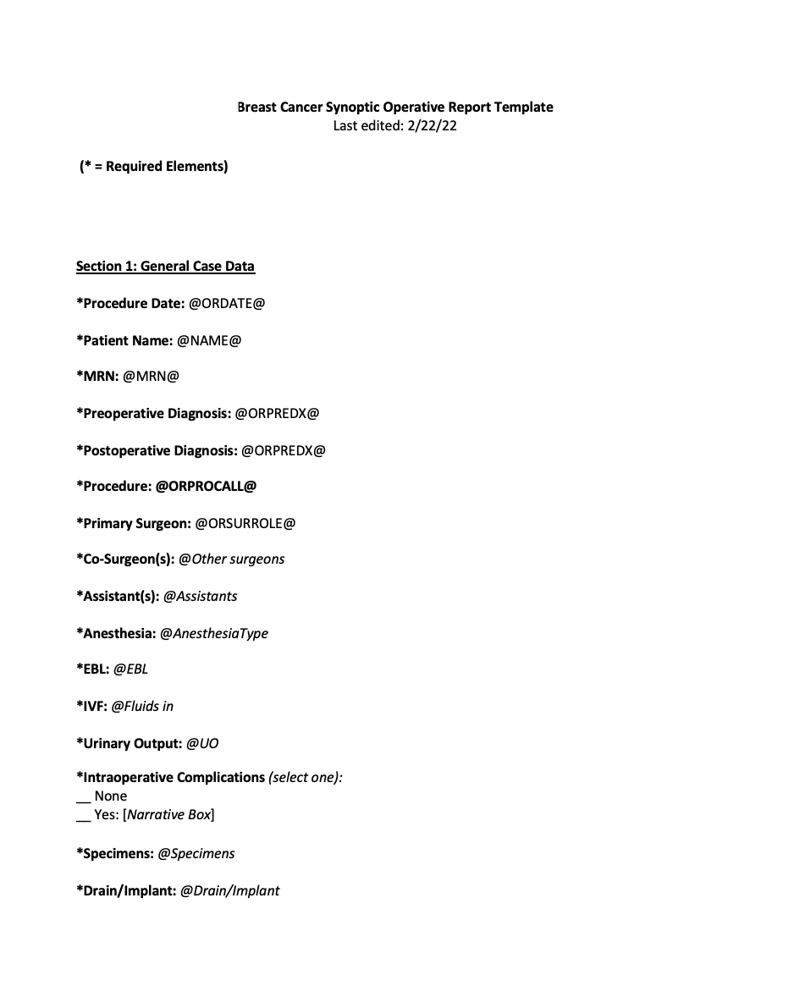
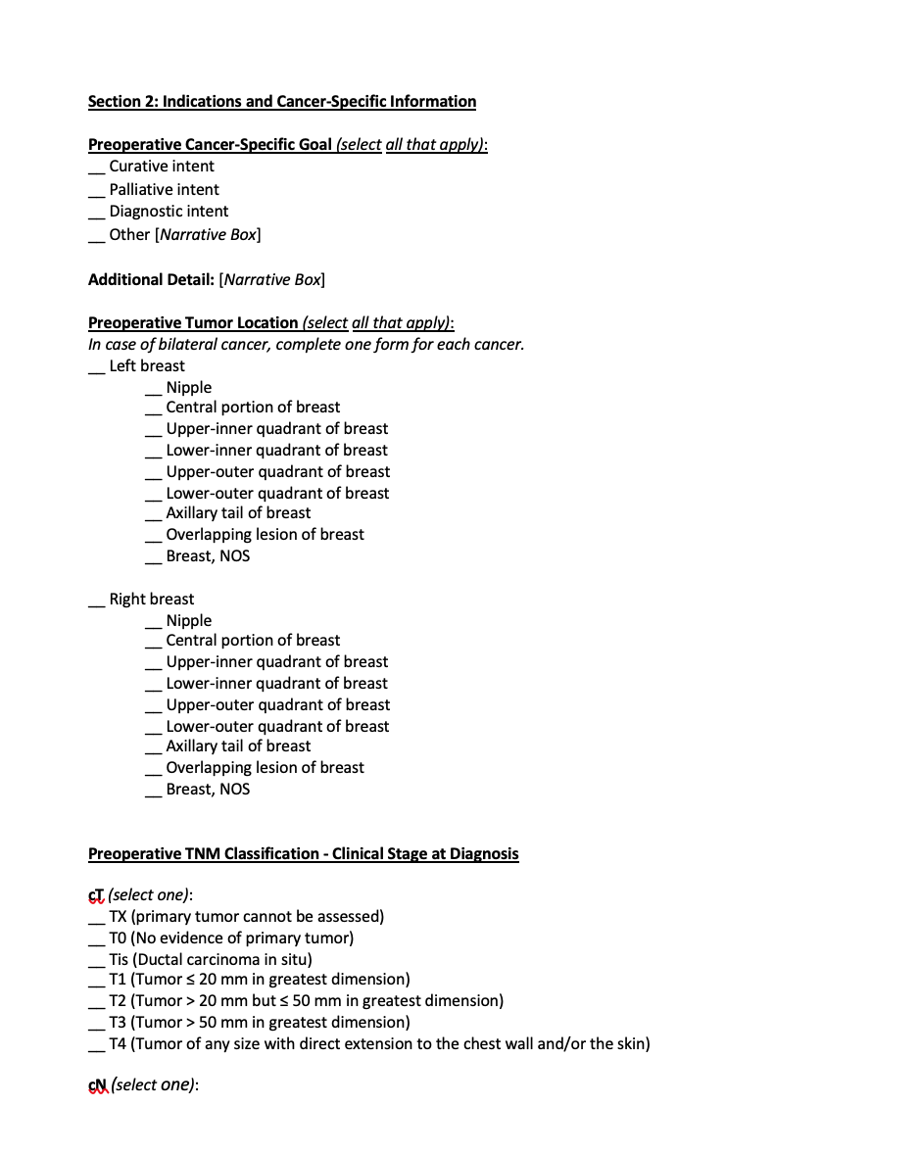
2. Synoptic Operative Report Content

Slide 11
3. Make the case for change
Stakeholder Analysis
  Clinical & Non-Clinical (e.g., billing/coding, compliance)
Engaging Stakeholders
  Talking Points and Considerations
Cancer Committee Presentation
  Slide deck
Quality & Process Improvement Resources
  Change Management, Project and Work Plan Templates

Slide 12
4. Implement your solutions
Sentinel Lymph Node Biopsy
Substrate(s) used for SLNBx | In the {BLANKLIST CH CLN:30424006::"NAC Setting","Non-NAC Setting"}: {BLANKLIST CH CLN:30424006::"Dye","Radiotracer","Clips","Dye and Radiotracer"}
All colored nodes or non-colored nodes at end of blue lymphatics were removed | {BLANKLIST CH CLN:30424006::"Yes","No","N/A"}
All significantly radioactive nodes were removed | {BLANKLIST CH CLN:30424006::"Yes","No","N/A"}
All palpably suspicious nodes were removed | {BLANKLIST CH CLN:30424006::"Yes","No","N/A"}
Clipped nodes were removed: | {BLANKLIST CH CLN:30424006::"Yes","No","N/A"}
Axillary Dissection
Resection performed within the boundaries of the axillary vein, chest wall (serratus anterior), and latissimus dorsi | {BLANKLIST CH CLN:30424006::"Yes","No"}
The long thoracic and thoracodorsal nerves were spared during dissection | {BLANKLIST CH CLN:30424006::"Yes","No","Not identified"}
Attempts were made to spare the intercostobrachial nerves during dissection if possible | {BLANKLIST CH CLN:30424006::"Yes","No"}
Were any level III nodes are removed? (If so then document why) | {BLANKLIST CH CLN:30424006::"Yes-***","No"}
Notes:
Different options for the actual operative reports (EMR tool, including Epic, commercial, homegrown options, to as simple as dot phrases)

Slide 13
5. Document your implementation plan (prepare for CoC Site Visits)
Recommended Content for Implementation Plans for CoC Standards 5.3-5.6 | ILCC’s Hospital Documentation
1. Describe how the cancer committee reviewed the CoC Operative Standards, their intent, and the requirements, including the date of the meeting(s) at which this was discussed | Synoptic Reporting Charter Cancer Committee Slides
2. Describe all education and training activities conducted or planned for surgeons, pathologists, and registrars for Standards 5.3-5.6 | Synoptic Reporting Educational Handout Meeting Agenda Template Log of Meeting Dates and Agendas List of ILCC Synoptic Operative Reporting Meetings Attended
3. Describe any internal audit process undertaken or planned to review compliance levels prior to the site review (if applicable) | Internal audit guidelines and processes
4. Describe any processes put in place or planned at your facility to facilitate synoptic reporting and data collection, including any coordination with IT, the surgery department, the registry, etc. | Description of Work Plan Log of Meeting Dates and Agendas Policy and Procedure Template Draft Language for Inclusion in Medical Records Content Policy Synoptic Operative Report Content Sample EMR Solution Screenshots
5. Outline the implemented or planned approach for synoptic reporting for Standards 5.3-5.6 and proposed timeline for complete implementation by January 1, 2023 | Description of Work Plan Synoptic Operative Report Content ILCC Timeline

Slide 14
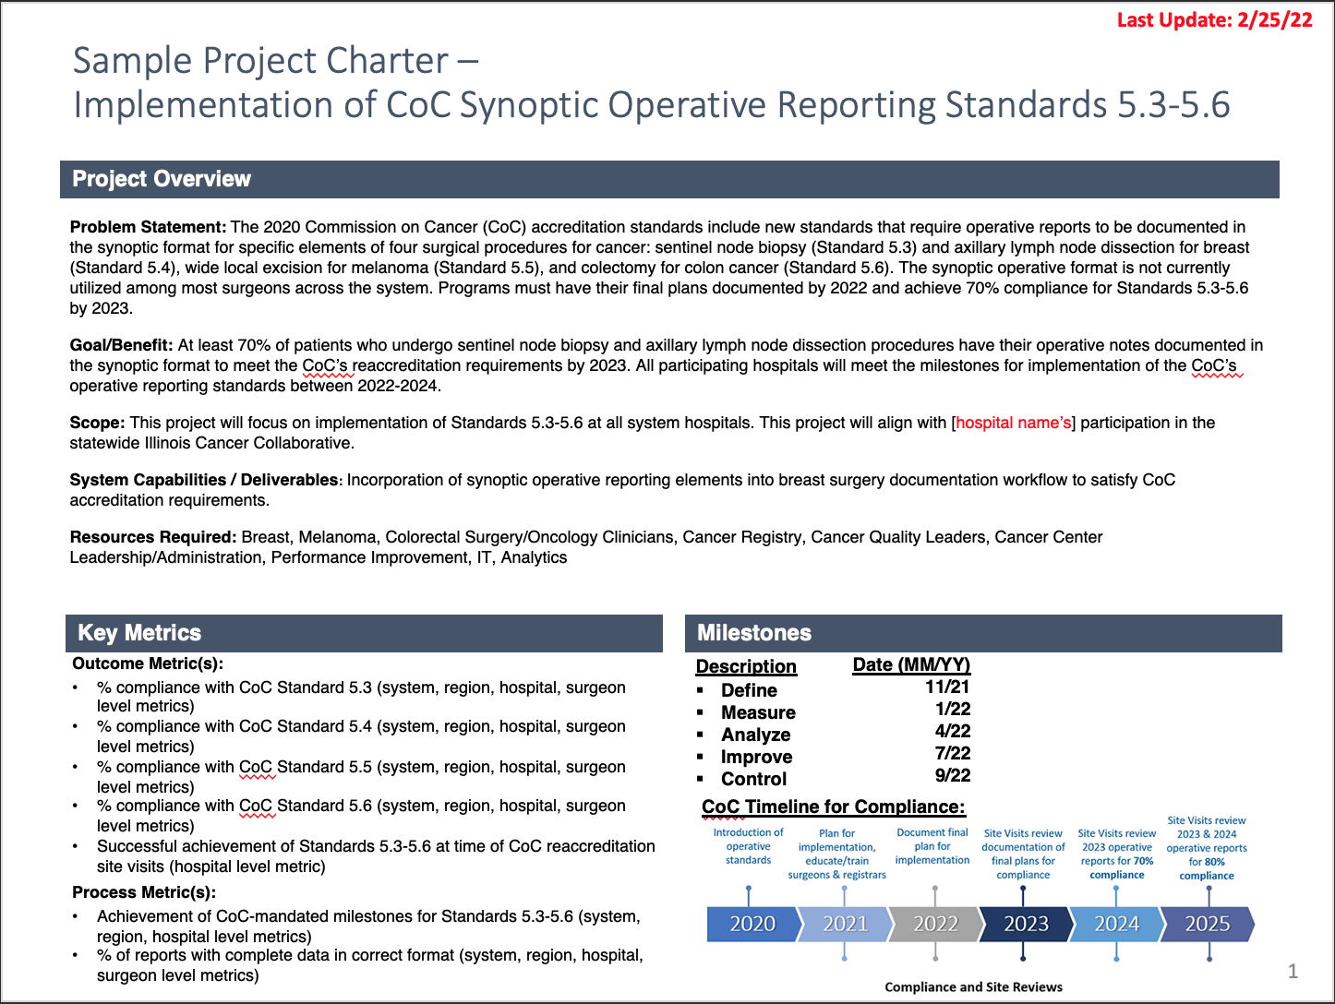
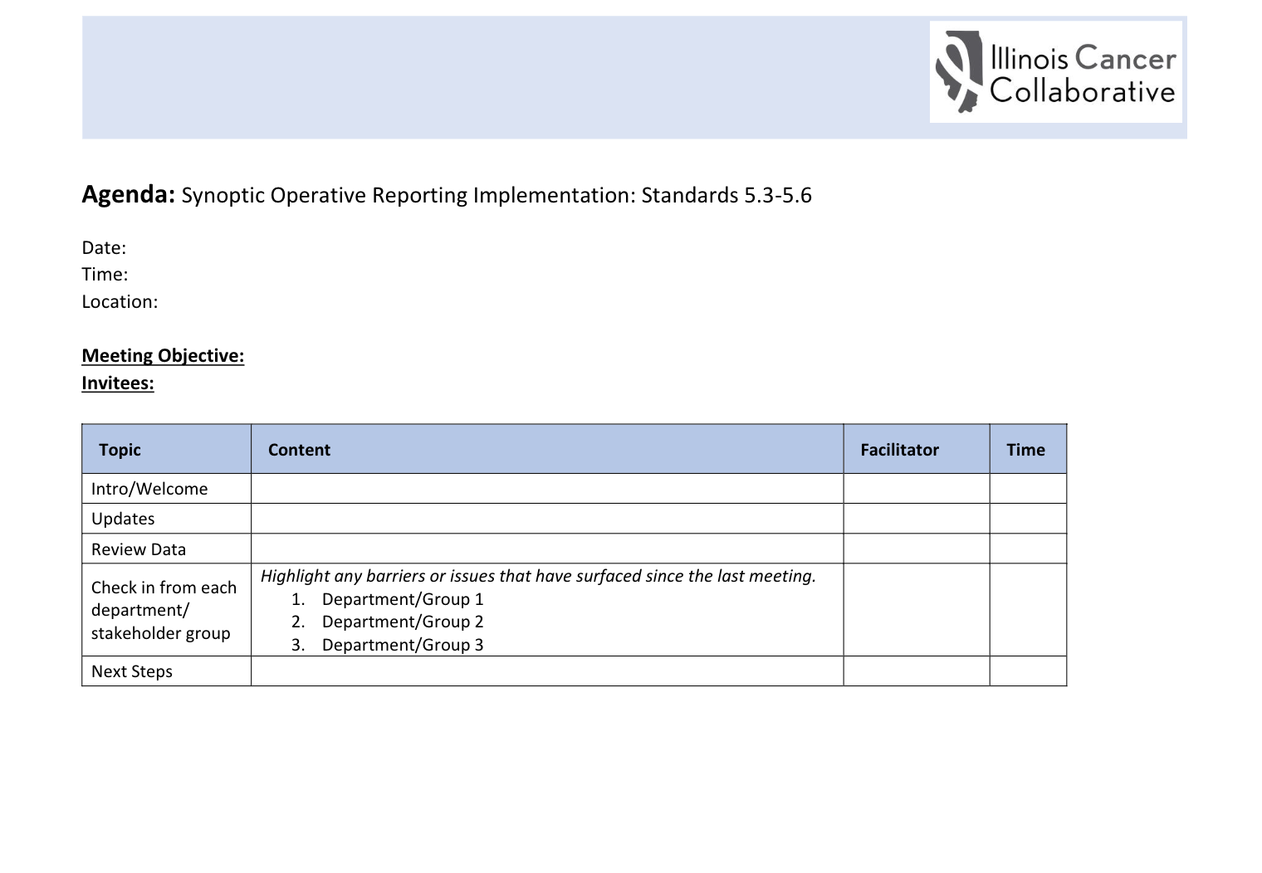
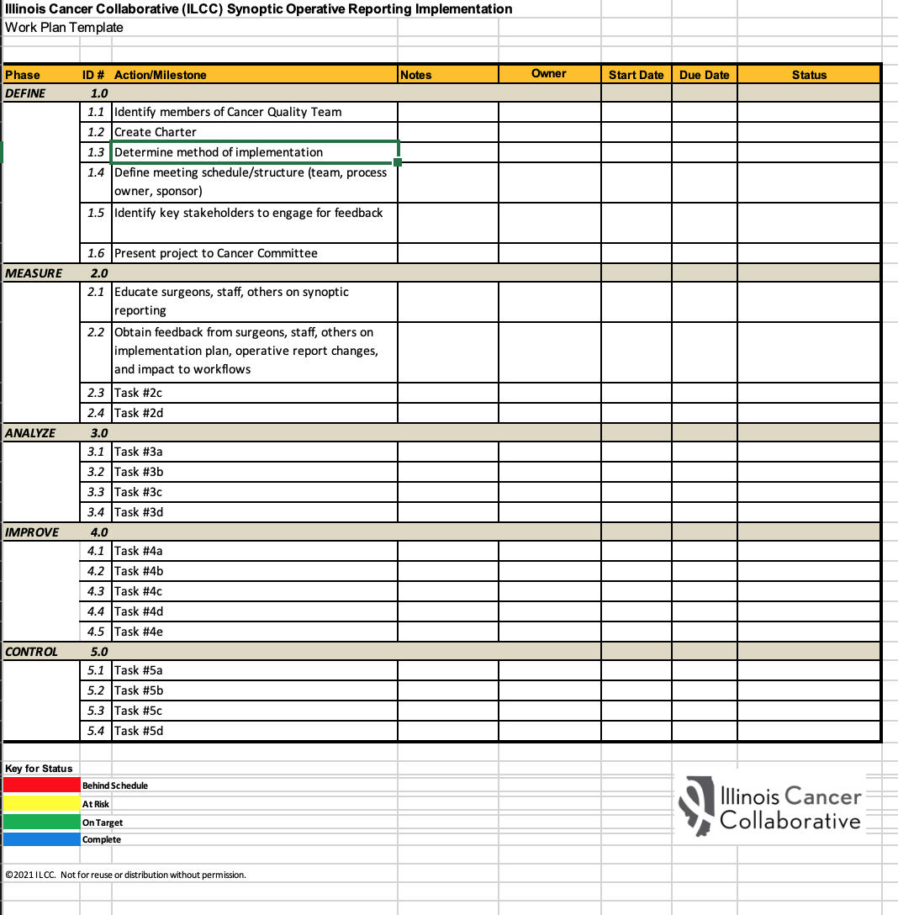
5. Document your implementation plans

Slide 15
6. Track compliance
Analytic tools
CoC case identification tipsheets for registrars
Data feedback mechanisms

Slide 16
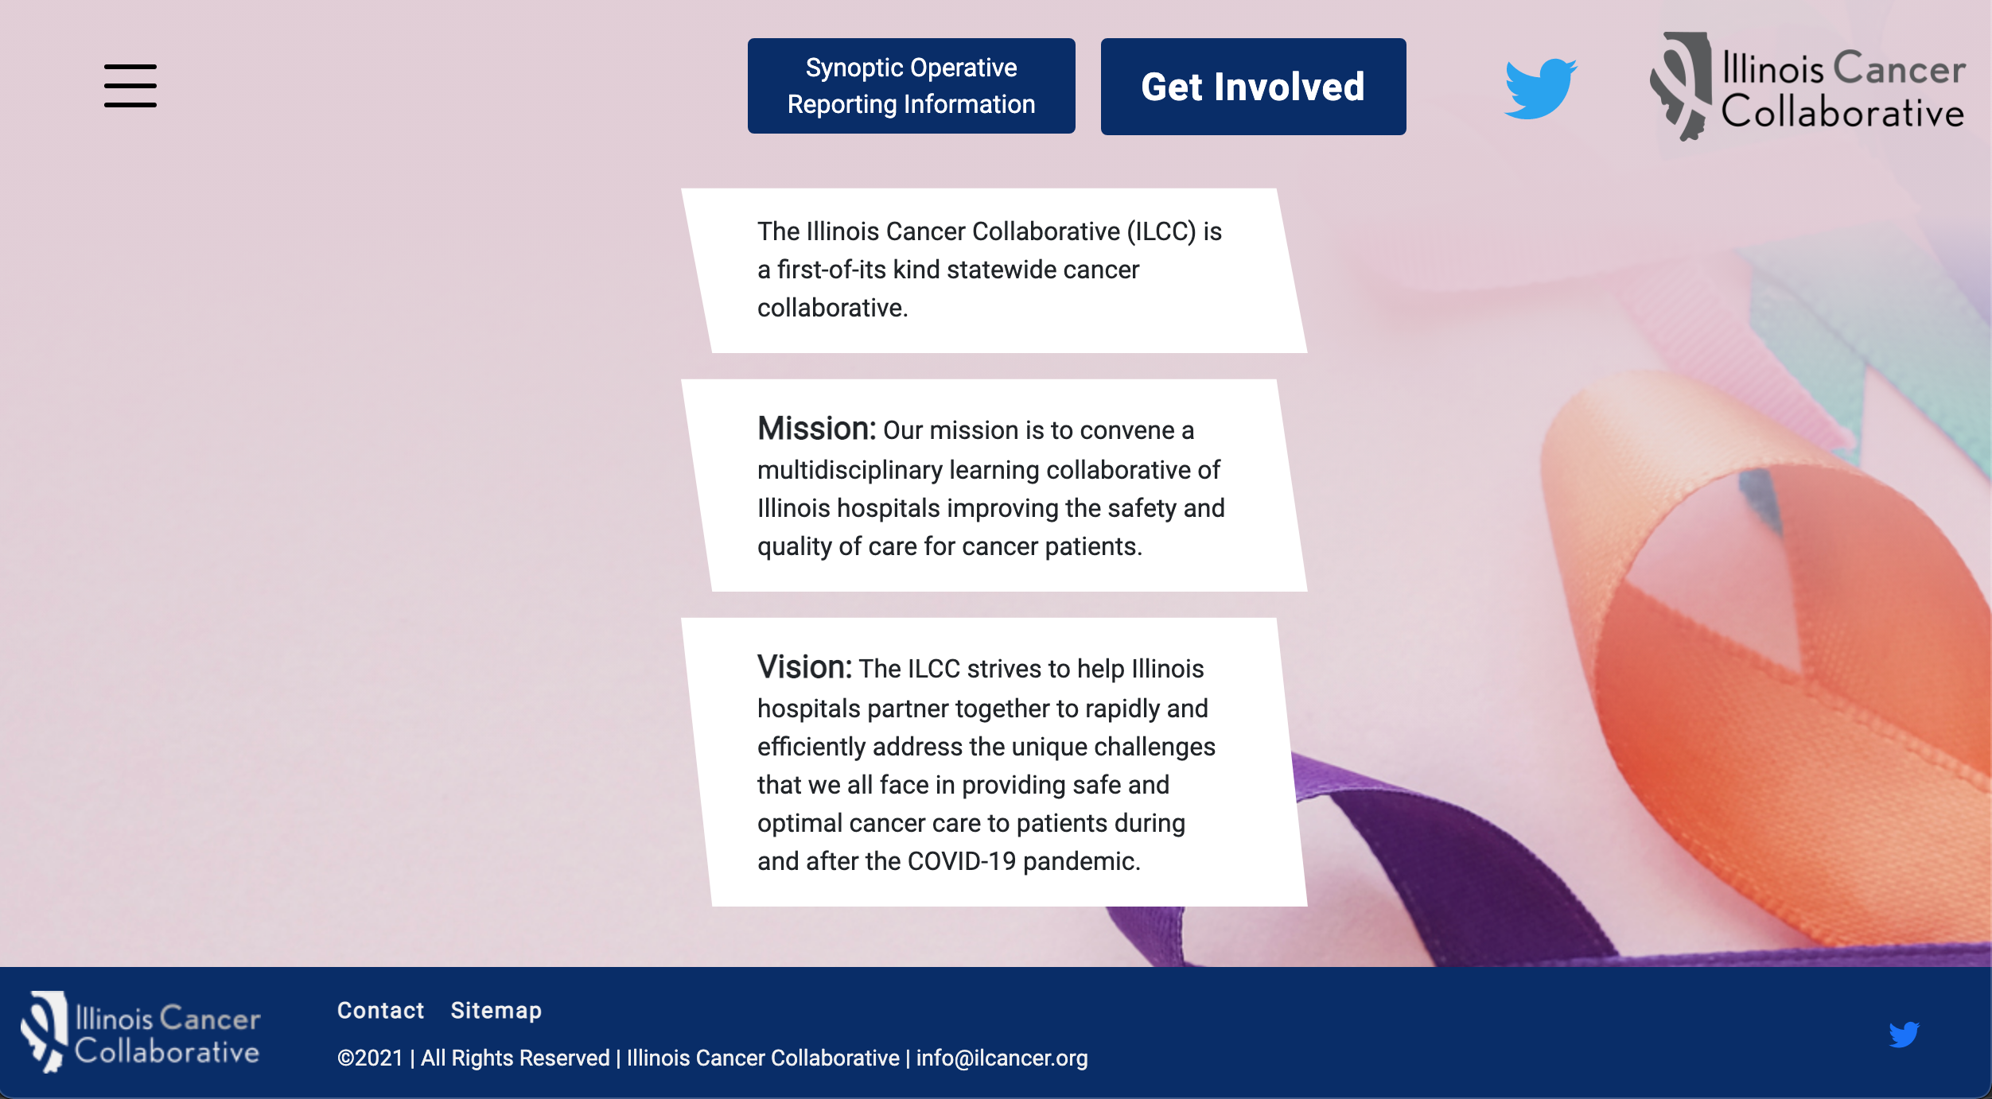
Visit the *new* ilcancer.org to access

Slide 17
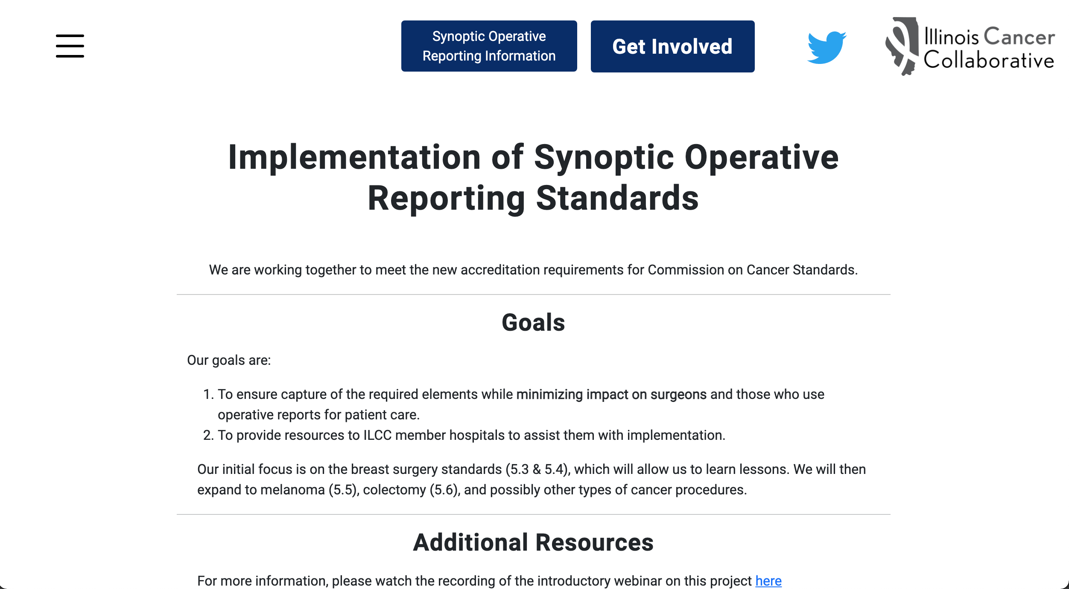

This Photo by Unknown Author is licensed under CC BY-NC

Slide 18

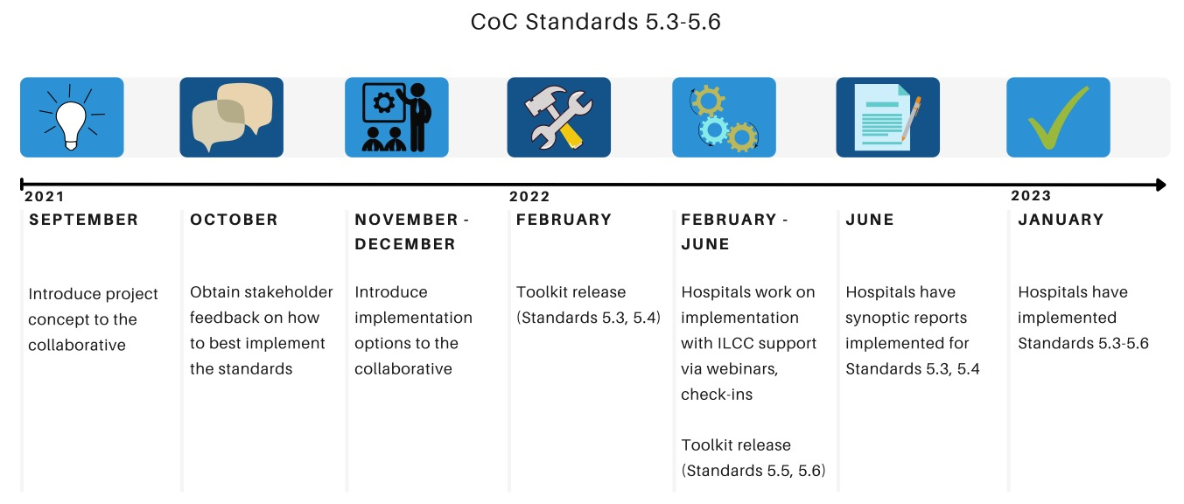
ILCC/ISQIC Project
Implementation Timeline
MARCH

Slide 19
Discussion
What toolkit resources do you think will be most helpful to your hospital?
What other resources do you need to implement the synoptic operative reporting standards?
What implementation option have you chosen / are you considering?
What are some of the barriers you are facing or anticipate facing with implementing synoptic operative reporting at your hospital?
Who do you need to engage at your hospital as part of your QI team?
© 2021 ILCC. Not for reuse or distribution without permission

Slide 20
Next Steps
ILCC Teams:
Let us know what implementation option you have selected
Let us know what other resources you need to succeed
    Coordinating Center:
    Toolkit will be released soon on ilcancer.org
      We will send out an announcement along with the release
    If you have not signed up yet, but would like to participate, please email us (ayang@ilcancer.org, info@ilcancer.org)
© 2021 ILCC. Not for reuse or distribution without permission

Slide 21
Questions?
Tony Yang, MD, MS
Director
Brianna D’Orazio, MPH
Administrative Coordinator
John Slocum, MPH
Project Coordinator
Reach us at info@ilcancer.org, ayang@ilcancer.org
Website: ilcancer.org

Slide 22
Appendix

Slide 23

New CoC Operative Reporting Standards
Synoptic formatting of cancer surgery operative reports
  Will now be required for cancer program accreditation
New way to format, input data for important components of cancer operations (specific data in defined fields)
Intent:
  Improve documentation accuracy, consistency, efficiency
  Improve efficiency of data abstraction, measurement of quality
Very different from most current practice
https://www.facs.org/quality-programs/cancer/news/program-requirements-091620
Notes:
- Lung Cancer guideline coming soon

Slide 24
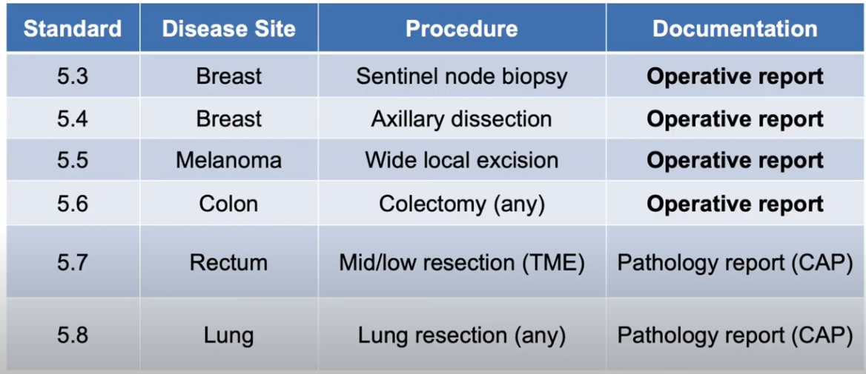
Synoptic Operative Reports
https://www.facs.org/quality-programs/cancer/news/program-requirements-091620

Slide 25
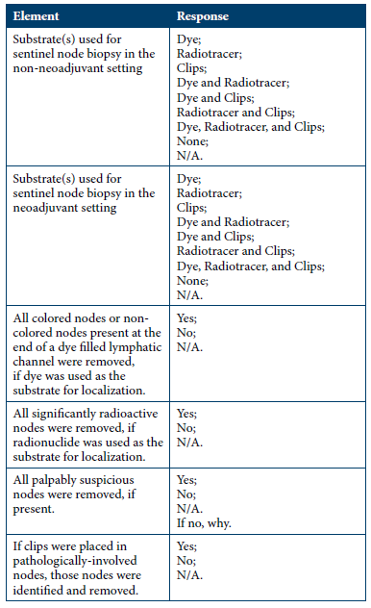

Breast SNB
6 items
Room for logic to be built into questions

Slide 26
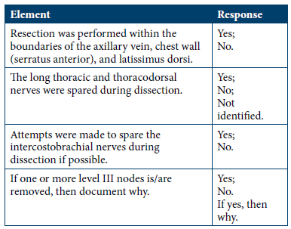
Breast Axillary Dissection
4 items

