Slide 1
Synoptic Operative Reporting for Breast Cancer Procedures: Implementation Options & Timeline
December 17, 2021
ilcancer.org

Slide 2
Housekeeping
Please stay on mute unless you have a question
Enter questions in the chat anytime or ask them after the presentation
The recording will be shared on ilcancer.org after the presentation

Slide 3
Our Approach to Implementing Synoptic Operative Reporting Standards
1. Work together to meet new mandate
Initial focus: breast surgery
Learn lessons, expand to others
2. Preparation for smooth implementation
Focus groups and surveys of stakeholders
https://northwestern.az1.qualtrics.com/jfe/form/SV_elMMKTjDLGSlvAG
3. Toolkit for implementation
Minimize impact on surgeons and those who use operative reports for patient care
Offer several options for implementation (EMR templates, dictation resources
Minimal cost EMR option (eDocSS)

Slide 4
Initial Feedback – Breast Surgeon Focus Group
Content
Large trials show >4 nodes don’t add value, so we often stop at 4. Does the report allow for tracer-labelled nodes to be left behind if >4 nodes have been removed?
Format
Will dictation (Dragon) still be an option?
Need a narrative option or room for comments to help with interpretation/use for patient care
Scope
Is the goal to completely replace the narrative note?
Does this apply to both the brief and longer op notes?
Concerns from medicolegal perspective
Other Clinical Users
Radiation oncology, pathology

Slide 5
ILCC Provider Survey – “Stakeholder Analysis”
Goal was to gather feedback on:
(1) Current practices of writing and using operative notes
(2) Experience with and concerns regarding the synoptic format
36 responses to date
General Surgery (n=7)
Breast Surgery (n=12)
Surgical Oncology (n=3)
Medical Oncology (n=3)
Radiation Oncology (n=1)
Breast Radiology (n=2)
Pathology (n=1)
Primary Care/Referring Providers (n=1)
Lymphedema Therapists (n=5)
Other (n=1)
Thank you to those who participated!

Slide 6
Ease of including or finding the information needed for clinical care
Surgeons
Non-surgical clinicians

Slide 7
Consistency of the information included in the operative notes
Surgeons
Non-surgical clinicians

Slide 8
Do you have experience with using synoptic operative reports?

Slide 9
What are some concerns you have regarding synoptic operative reporting?
Themes:
Concerns about additional time
Current process works for me
Less autonomy
*
*Other:
Resident training to do op notes
Repetition between itemized list and narratives

Slide 10
Resources for Implementation of Synoptic Operative Reporting Standards: The ILCC Toolkit
ILCC Synoptic Operative Reporting Implementation Toolkit:
CoC Standards 5.3-5.6
Version 1.0

Slide 11
Toolkit Contents
Release date: February 2022
Implementation Strategies & Roadmap
Stakeholder analysis
Gathering feedback from surgeons, other clinicians who read operative notes
Engaging billing, compliance, and other regulatory structures
Synoptic Operative Report Templates and Other Resources
SNB, axillary dissection only
Other synoptic operative notes for breast surgery (mastectomy, lumpectomy, oncoplastic recon.)
EMR solutions
Templates, smartphrases, tip sheets
Resources for surgeons who dictate their notes
Change management resources
Team roles and responsibilities
Talking points - Making the case to surgeons and other stakeholders
Board / Cancer Committee slide deck
Resources for CoC Reaccreditation Site Visits
Documentation of final plans for compliance (due 2023)
Project Charter Template
Description of Workplans and Implementation
List of ILCC/ISQIC QI Team meeting dates
Monitoring and feedback - tracking compliance with the new standards
Analytic tools

Slide 12
Sample EMR Template

Slide 13
Sample Smartphrases
Sentinel Lymph Node Biopsy
Substrate(s) used for SLNBx | In the {BLANKLIST CH CLN:30424006::"NAC Setting","Non-NAC Setting"}: {BLANKLIST CH CLN:30424006::"Dye","Radiotracer","Clips","Dye and Radiotracer"}
All colored nodes or non-colored nodes at end of blue lymphatics were removed | {BLANKLIST CH CLN:30424006::"Yes","No","N/A"}
All significantly radioactive nodes were removed | {BLANKLIST CH CLN:30424006::"Yes","No","N/A"}
All palpably suspicious nodes were removed | {BLANKLIST CH CLN:30424006::"Yes","No","N/A"}
Clipped nodes were removed: | {BLANKLIST CH CLN:30424006::"Yes","No","N/A"}
Axillary Surgery
Resection performed within the boundaries of the axillary vein, chest wall (serratus anterior), and latissimus dorsi | {BLANKLIST CH CLN:30424006::"Yes","No"}
The long thoracic and thoracodorsal nerves were spared during dissection | {BLANKLIST CH CLN:30424006::"Yes","No","Not identified"}
Attempts were made to spare the intercostobrachial nerves during dissection if possible | {BLANKLIST CH CLN:30424006::"Yes","No"}
Were any level III nodes are removed? (If so then document why) | {BLANKLIST CH CLN:30424006::"Yes-***","No"}

Slide 14
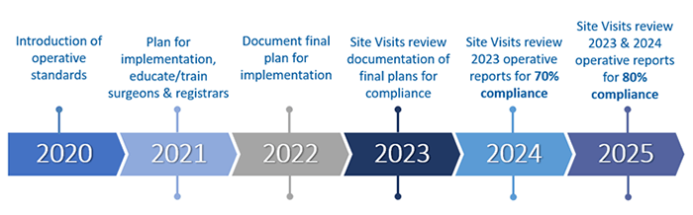
Project Implementation Timeline

Slide 15
Discussion
What are some of the barriers you are facing or anticipate facing with implementing synoptic operative reporting at your hospital?
Who do you need to engage at your hospital as part of your QI team?
When is your hospital’s next CoC site visit?
Are you interested in working on melanoma and colorectal standards (5.5, 5.6) in addition to the breast procedures (5.3, 5.4)?
What additional resources do you need from us to succeed?
© 2021 ILCC. Not for reuse or distribution without permission

Slide 16
Next Steps
ILCC Teams:
Let us know who will be on your QI Team:
ayang@ilcancer.org; info@ilcancer.org
Team lead (probably breast surgeon)
Other clinicians (other surgeons, other stakeholders – e.g., rad onc, path, biller/coder)
Quality leader (or other connection to local quality structure/CoC accreditation)
Administration representative
Cancer Registrar
Coordinating Center:
Toolkit development
© 2021 ILCC. Not for reuse or distribution without permission

Slide 17
Questions?
Tony Yang, MD, MS
Director
Brianna D’Orazio, MPH
Administrative Coordinator
John Slocum, MPH
Project Coordinator
Reach us at info@ilcancer.org, ayang@ilcancer.org
Website: ilcancer.org

Slide 18
Appendix

Slide 19
New CoC Operative Reporting Standards
Synoptic formatting of cancer surgery operative reports
Will now be required for cancer program accreditation
New way to format, input data for important components of cancer operations (specific data in defined fields)
Intent:
Improve documentation accuracy, consistency, efficiency
Improve efficiency of data abstraction, measurement of quality
Very different from most current practice
https://www.facs.org/quality-programs/cancer/news/program-requirements-091620
Notes:
- Lung Cancer guideline coming soon

Slide 20
Synoptic Operative Reports
https://www.facs.org/quality-programs/cancer/news/program-requirements-091620

Slide 21
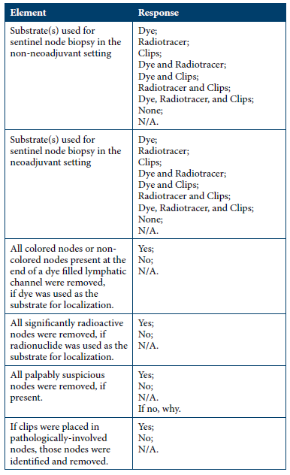
Breast SNB
6 items
Room for logic to be built into questions

Slide 22
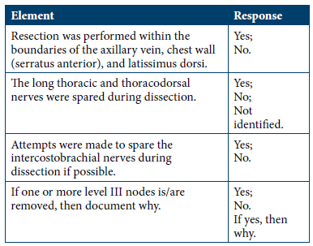
Breast Axillary Dissection
4 items

Slide 23
Sample Report – Generic Example
Operative Report
PROCEDURE DATE
PREOPERATIVE DIAGNOSIS
POSTOPERATIVE DIAGNOSIS
PROCEDURE(s)
SURGEON(s): Surgeon(s) and Role
CO-SURGEON(s)
ASSISTANTS
ANESTHESIA TYPE
DVT PROPHYLAXIS
SURGICAL INDICATIONS: Brief narrative vs. choice of indication phrases
INTRAOPERATIVE FINDINGS: Brief Narrative vs. choice of indication phrases
PREOPERATIVE SAFETY CHECKLIST STATEMENT: Brief narrative vs. choice of indication phrases
Automatically pull-in data as much as possible
Working with billing/compliance

Slide 24
Sample Report – Generic
Example
DETAILS OF THE PROCEDURE
EXPLORATION
Patient position
Operative approach
Preoperative biopsy
Intraoperative biopsy
Primary intent of resection
Notes (narrative form)
RESECTION
Procedure
Location
Method
Structures identified and preserved
Notes (narrative form)
SNB
Substrate used
Node removal
All colored nodes or non-colored nodes present at the end of a dye filled lymphatic channel were removed, if dye was used as the substrate for localization
All significantly radioactive nodes were removed, if radionuclide was used as the substrate for localization
All palpably suspicious nodes were removed, if present
If clips were placed in pathologically-involved nodes, those nodes were identified and removed
Notes (narrative form)

Slide 25
Sample Report – Generic Example
ADDITIONAL PROCEDURES
Notes (narrative form)
CLOSURE STATEMENT
Drains:
Drain Type:
Skin Closure:
Sponge Count Correct:
Needle Count Correct:
COMPLICATIONS
SPECIMENS REMOVED
URINE OUTPUT (mL)
ESTIMATED BLOOD LOSS (mL)
FLUIDS ADMINISTERED
OUTCOME

Slide 26
Sample Report 2 – Detailed Breast-Specific Example
Section 1: EMR Autopopulated Information
Patient Name*
Patient ID*
Date of surgery*
Name of surgeon*
Name of co-surgeon
Name of assistant(s)
Indication for surgery*
Preoperative diagnosis*
Postoperative diagnosis*
Procedure(s) performed*
Specimens removed
Type of anesthesia
Estimated blood loss
Drain/Implant
Additional administrative details

Slide 27
Detailed Breast-Specific Example
Section 2: Cancer-Specific Information (required)
Preoperative Cancer-Specific Goal*
Preoperative Cancer Type*
Preoperative Tumor Location*
Preoperative TNM Classification – Clinical Stage at Diagnosis*
Preoperative Therapy*

Slide 28
Detailed Breast-Specific Example
Section 2: Cancer-Specific Information (required) (continued) – Primary Tumor Resection
Mastectomy
Procedural Intent*
Mastectomy Type*
Type of Incision*
Tumescent Solution Used*
Pectoralis Fascia, Muscle, or Both Removed*
Reconstruction*
Drains Placed*
Partial Mastectomy/Lumpectomy
Procedural Intent*
Tumor Localization Method*
Skin, Pectoralis Fascia, or Both Excised with Specimen*
Confirmation of Removal of Target Lesion*
Cavity Margins Re-Excised*
Placement of Clips or Other Fiducial Markers to Aid Radiation Targeting*

Slide 29
Detailed Breast-Specific Example
Section 2: Cancer-Specific Information (required) (continued) – Lymph Node Assessment
Sentinel Lymph Node Biopsy
Tracers Used to Identify Sentinel Nodes In Neoadjuvant and Non-Neoadjuvant (Upfront Surgery) Setting*
Completeness of Sentinel and Palpable Node Removal*
Biopsy-proven Positive Nodes Marked with Clips Prior to Chemotherapy Identified and Removed*
Axillary Dissection
Resection Performed Within the Boundaries of Axillary Vein, Chest Wall (Serratus Anterior), and Latissimus Dorsi*
Level III Nodes Removed*
Nerves Identified and Preserved During the Dissection*
Drains Placed*

Slide 30
Detailed Breast-Specific Example
Section 3: Additional Procedure Details
Oncoplastic Reconstruction:
Advanced Tissue Transfer
Separate Incision Through the Parenchyma to Create a Pedicle Flap
Preservation of Vasculature
Dimensions of Defect
Dimensions of Tissue Mobilized
Mastopexy
Breast Reduction
Intraoperative Radiation
Additional Surgical Information
Intraoperative Complications

